Slide 1
GeoFenceX: Precision Tracking and Task Management
BY : (Batch – C5)
A. V. Krishna Sai - 22R21A05D1
S. Rajendra - 22R21A05J5
L. Vishvesh - 22R21A05G2
D. Sudharshan - 22R21A05E1
GUIDE:
Mrs. B. Manjusha

Slide 2
ABSTRACT
GeoFenceX a comprehensive solution for personal and professional tracking with dual interfaces for parental oversight and managerial tracking. Utilizing GeoFencing technology for real-time monitoring, this system features safe zones for children with boundary alerts, task adherence monitoring for workforce optimization, and integrated task management for scheduled activities. Enhance safety and productivity seamlessly across various settings.

Slide 3
INTRODUCTION
In today's dynamic and fast-paced world, ensuring the safety and productivity of individuals, whether in personal or professional spheres, has become increasingly paramount. To address these challenges, the emergence of innovative technologies has paved the way for comprehensive solutions that cater to both parental oversight and managerial tracking needs. Among these, GeoFenceX stands out as a pioneering system that harnesses the power of GeoFencing technology to redefine how we manage real-time movements and tasks.
Safety
Security
Productivity
Efficiency

Slide 4
PROBLEM STATEMENT
Existing tracking technologies lack comprehensive solutions for ensuring the safety and productivity of individuals in real-time, both in personal and professional settings. GeoFenceX aims to fill this gap by leveraging GeoFencing technology to revolutionize movement and task management, setting a new standard in efficiency and safety.
Safety
Productivity

Slide 5
LITERATURE SURVEY
S.NO | YEAR | AUTHOR | TITLE | FOCUS
1 | 2016 | Kim, Lee | Geofencing-enabled task management app | Analyzes user behaviors, usage patterns, and satisfaction levels over time with geofencing-based task management systems.
2 | 2017 | Chen, Li, Liu | User privacy concerns in geofencing-based application | Examines factors influencing user perceptions of privacy risks, data collection practices, and control mechanisms in geofencing systems.
3 | 2018 | Jiang, Li, Wang | User experience design considerations for geofencing-based task management applications | Covers aspects such as interface design, notification mechanisms, and task organization specific to task management systems utilizing geofencing technology.
4 | 2019 | Park, Kim | Geofencing notifications in task management app | Likely examines factors like notification frequency, content, and customization options based on user feedback.
5 | 2020 | Gupta, Jayaraman | User perceptions and acceptance of geofencing technology for location-based services | Likely explores factors influencing user attitudes, perceived usefulness, and adoption barriers related to geofencing.

Slide 6
DISADVANTAGES OF EXISTING SYSTEM
Battery Drain: Continuous location tracking can significantly reduce battery life, impacting daily device usage.
Accuracy Issues: GPS signal strength and environmental factors can affect accuracy, leading to false triggers or missed notifications.
Privacy and Data Security: Tracking user locations raises privacy concerns and requires robust data security to prevent unauthorized access.
Complex Deployment: Implementing geofencing involves integrating with existing systems, increasing development time and costs.
Poor Interface: No proper task management system with safe zones and location tracking.

Slide 7
PROPOSED SOLUTION
Develop a comprehensive geofencing-based tracking and task management system for personal and professional use. Featuring dual interfaces for parental oversight and managerial tracking, it uses GeoFencing technology for real-time monitoring. Parents can set virtual boundaries for children's safety and get alerts for boundary breaches or incomplete tasks. Managers can define and monitor work boundaries to optimize productivity.
The system emphasizes data security, scalability, and modularity, integrating advanced security measures and a robust backend for real-time data processing. Utilizing GPS, open street maps API, and modern web technologies, it ensures cross-platform compatibility and a user-friendly interface.

Slide 8
ADVANTAGES OF PROPOSED SYSTEM
Enhanced Safety and Productivity: Real-time monitoring and alerts for prompt responses to boundary breaches and task assignments.
Scalable and Resilient Architecture: Modular design efficiently manages large volumes of users and data, ensuring robust performance.
User-Friendly Interfaces: Intuitive navigation and management of geofences, tasks, and alerts, enhancing user adoption and satisfaction.
Customization Options: Flexible settings for custom geofences, tasks, and alerts tailored to individual or organizational needs.
Privacy and Data Security: Robust data security measures, including encryption and privacy controls like time-limited and selective day tracking.

Slide 9
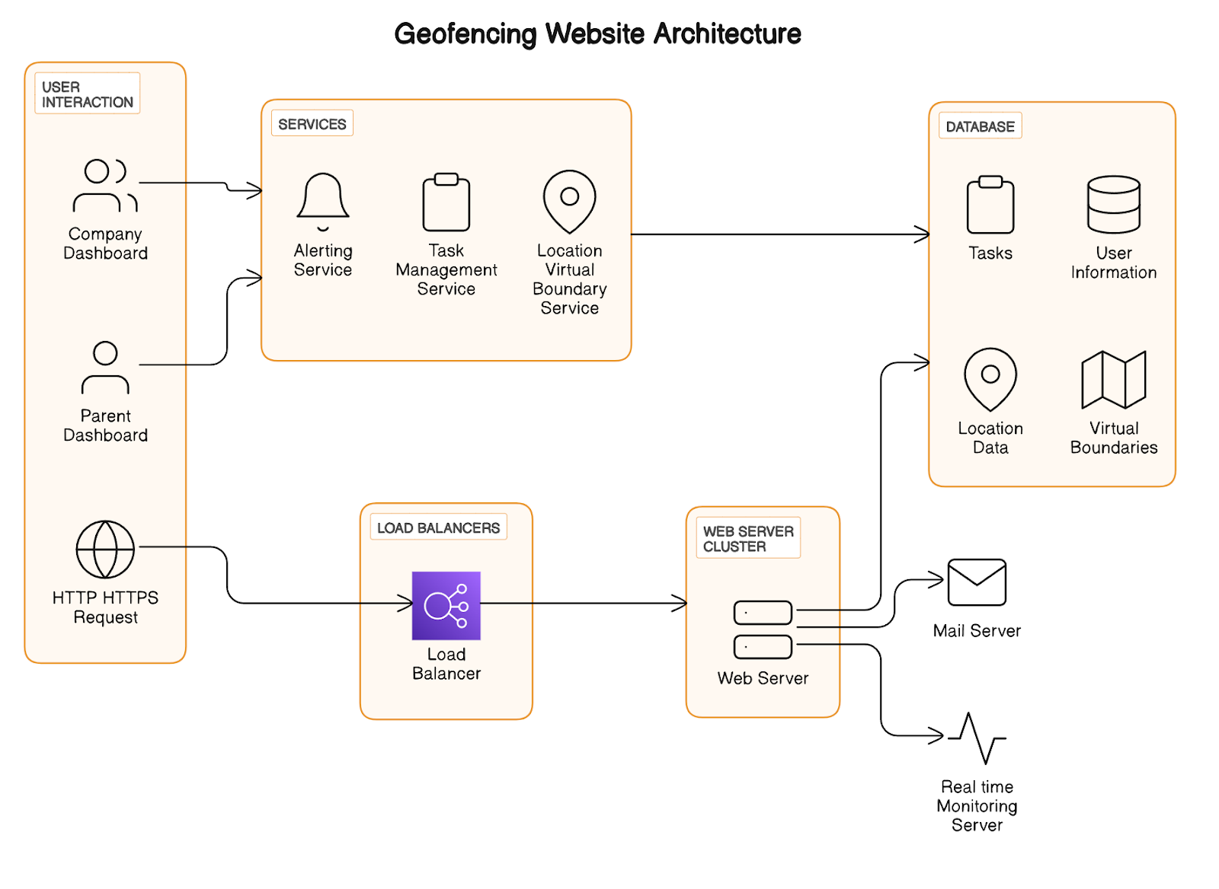
ARCHITECTURE

Slide 10
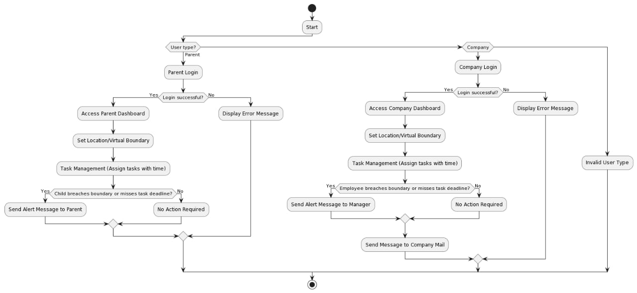
FLOW CHART

Slide 11
MODULES
1) PARENTAL LOGIN
4) DASHBOARD
5) ALERT SYSTEM
2) COMPANY LOGIN
3) DATABASE
6) LOCATION SETUP

Slide 12
PARENTAL LOGIN
COMPANY LOGIN
Virtual Boundaries and Task Management:
Parents can set boundaries and assign tasks with deadlines for their children.
Real-Time Alerts and Monitoring:
Sends notifications for boundary breaches or missed tasks and allows real-time activity monitoring.
User-Friendly Interface:
Easy navigation and management of parental controls through an intuitive dashboard.
Virtual Boundaries and Task Management:
Managers can set work area boundaries and assign tasks to employees.
Real-Time Alerts and Reporting:
Sends email notifications for boundary breaches or missed tasks and provides comprehensive performance insights.
Customizable Platform:
Tailor the system to meet specific company requirements.

Slide 13
DASBOARD MODULE
LOCATION SETUP MODULE
Easy Configuration:
Define and configure virtual boundaries on a map interface with user-friendly options.
Real-Time Preview and Editing:
Ensure accurate boundary setup with real-time preview and editing capabilities.
GPS Integration and Organization:
Integrates with GPS for precise boundaries, with features for labeling and categorizing.
Intuitive Boundary Definition:
Users can select and mark locations on a map with an intuitive interface.
Customizable Shapes and Parameters:
Set shapes and sizes of boundaries, including circular, rectangular, and polygonal options.
Multiple Boundary Management:
Save and manage multiple virtual boundaries for various purposes.

Slide 14
ALERT MODULE
DATABASE MODULE
Email and Push Notifications:
Alerts for boundary breaches or missed tasks, sent to managers and parents.
Customizable Preferences:
Customize alert preferences and frequency for both email and push notifications.
Real-Time and Seamless Integration:
Real-time alerts for timely intervention, integrating with other modules based on conditions.
Secure Storage:
Stores user profiles, location data, virtual boundaries, and task assignments securely.
Scalable and Performant:
Utilizes robust data storage mechanisms, supporting RDBMS or NoSQL databases.
Encryption and Integration:
Implements data encryption, access control, and seamless integration with other modules.

Slide 15
DASBOARD MODULE
LOCATION SETUP MODULE
Easy Configuration:
Define and configure virtual boundaries on a map interface with user-friendly options.
Real-Time Preview and Editing:
Ensure accurate boundary setup with real-time preview and editing capabilities.
GPS Integration and Organization:
Integrates with GPS for precise boundaries, with features for labeling and categorizing.
Intuitive Boundary Definition:
Users can select and mark locations on a map with an intuitive interface.
Customizable Shapes and Parameters:
Set shapes and sizes of boundaries, including circular, rectangular, and polygonal options.
Multiple Boundary Management:
Save and manage multiple virtual boundaries for various purposes.

Slide 16
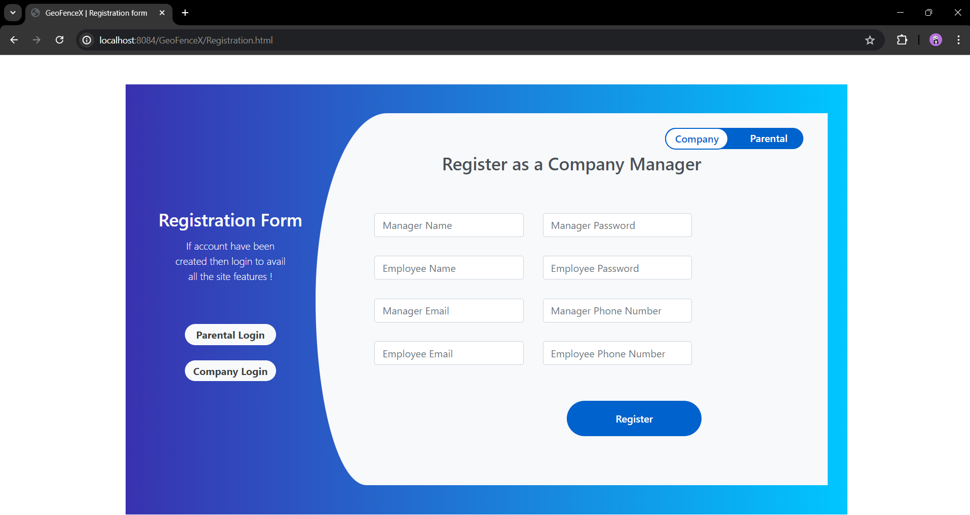
RESULTS
LANDING PAGE FOR HOME PAGE
REGISTRATION PAGE

Slide 17
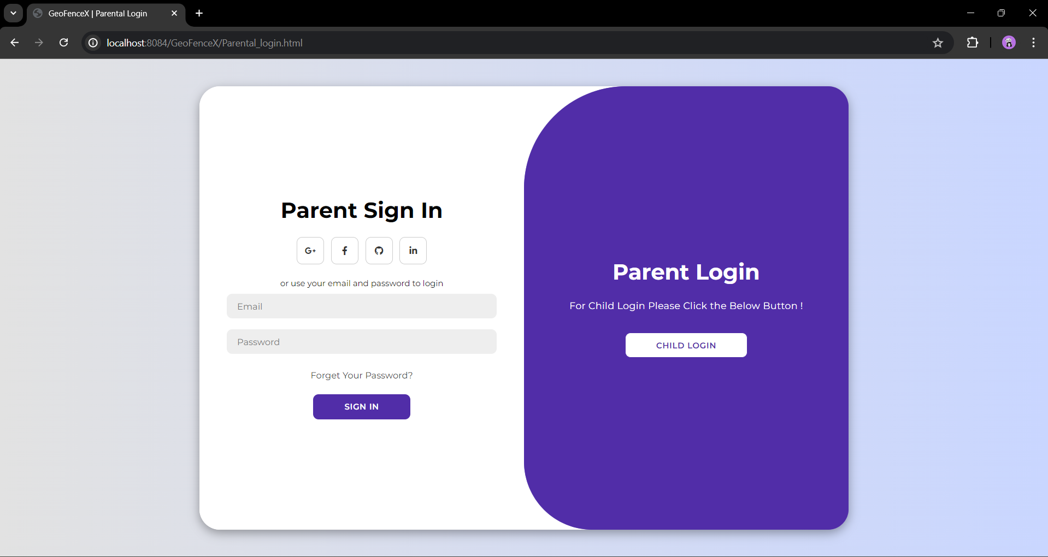
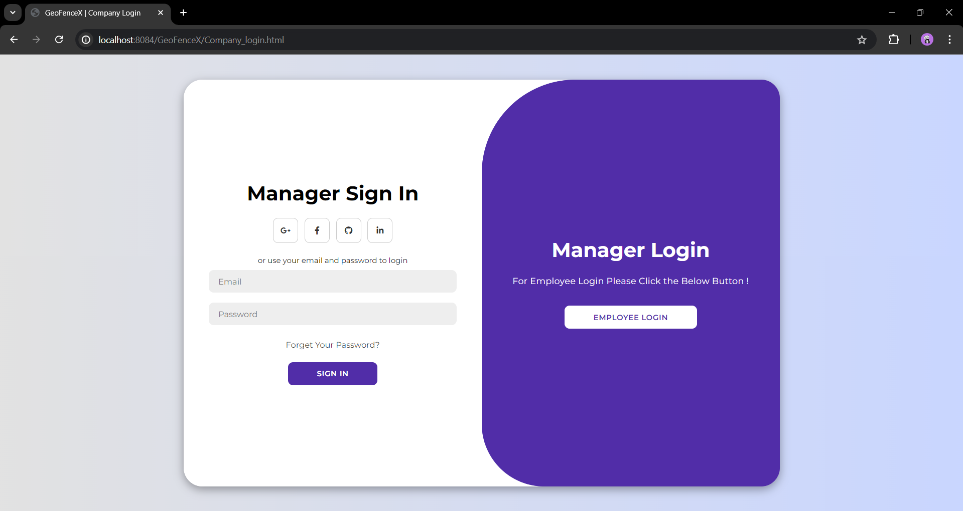
RESULTS
PARENTAL LOGIN PAGE
COMPANY LOGIN PAGE

Slide 18
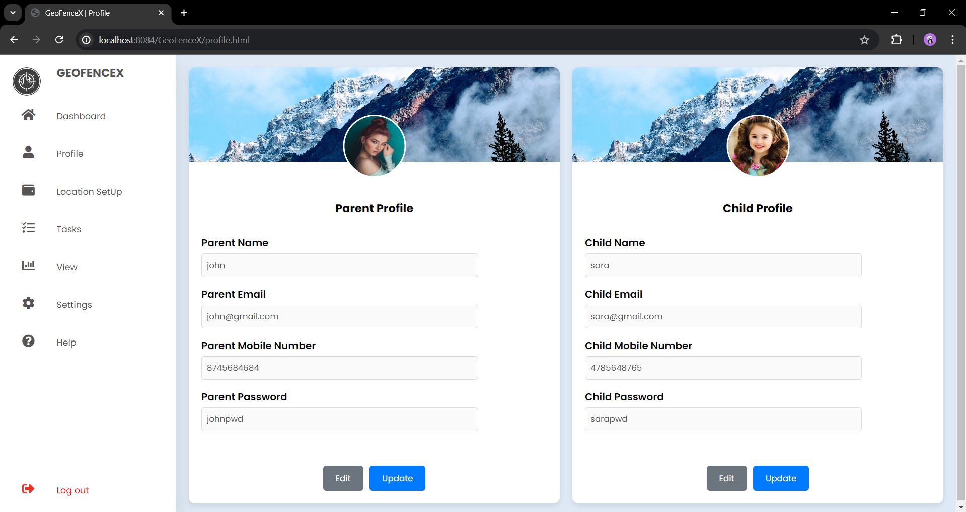
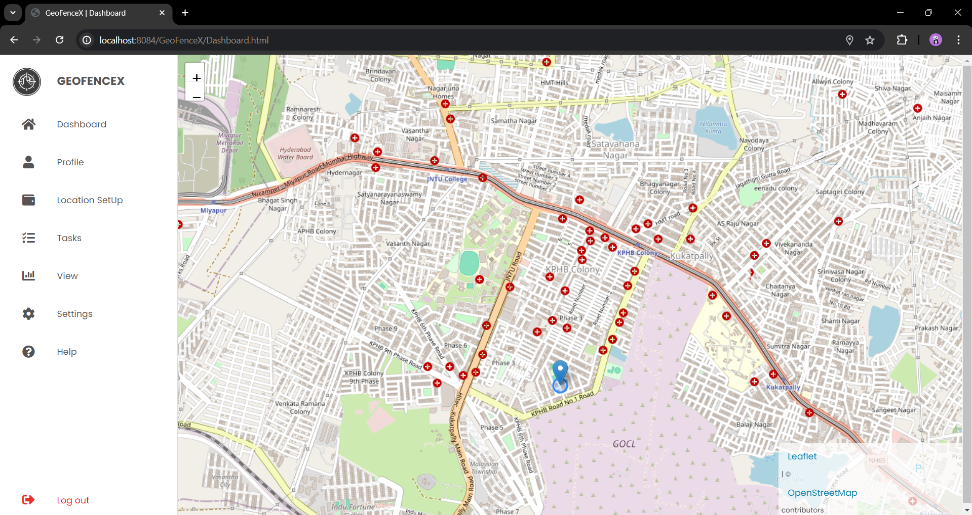
RESULTS
DASBOARD PAGE
PROFILE PAGE

Slide 19
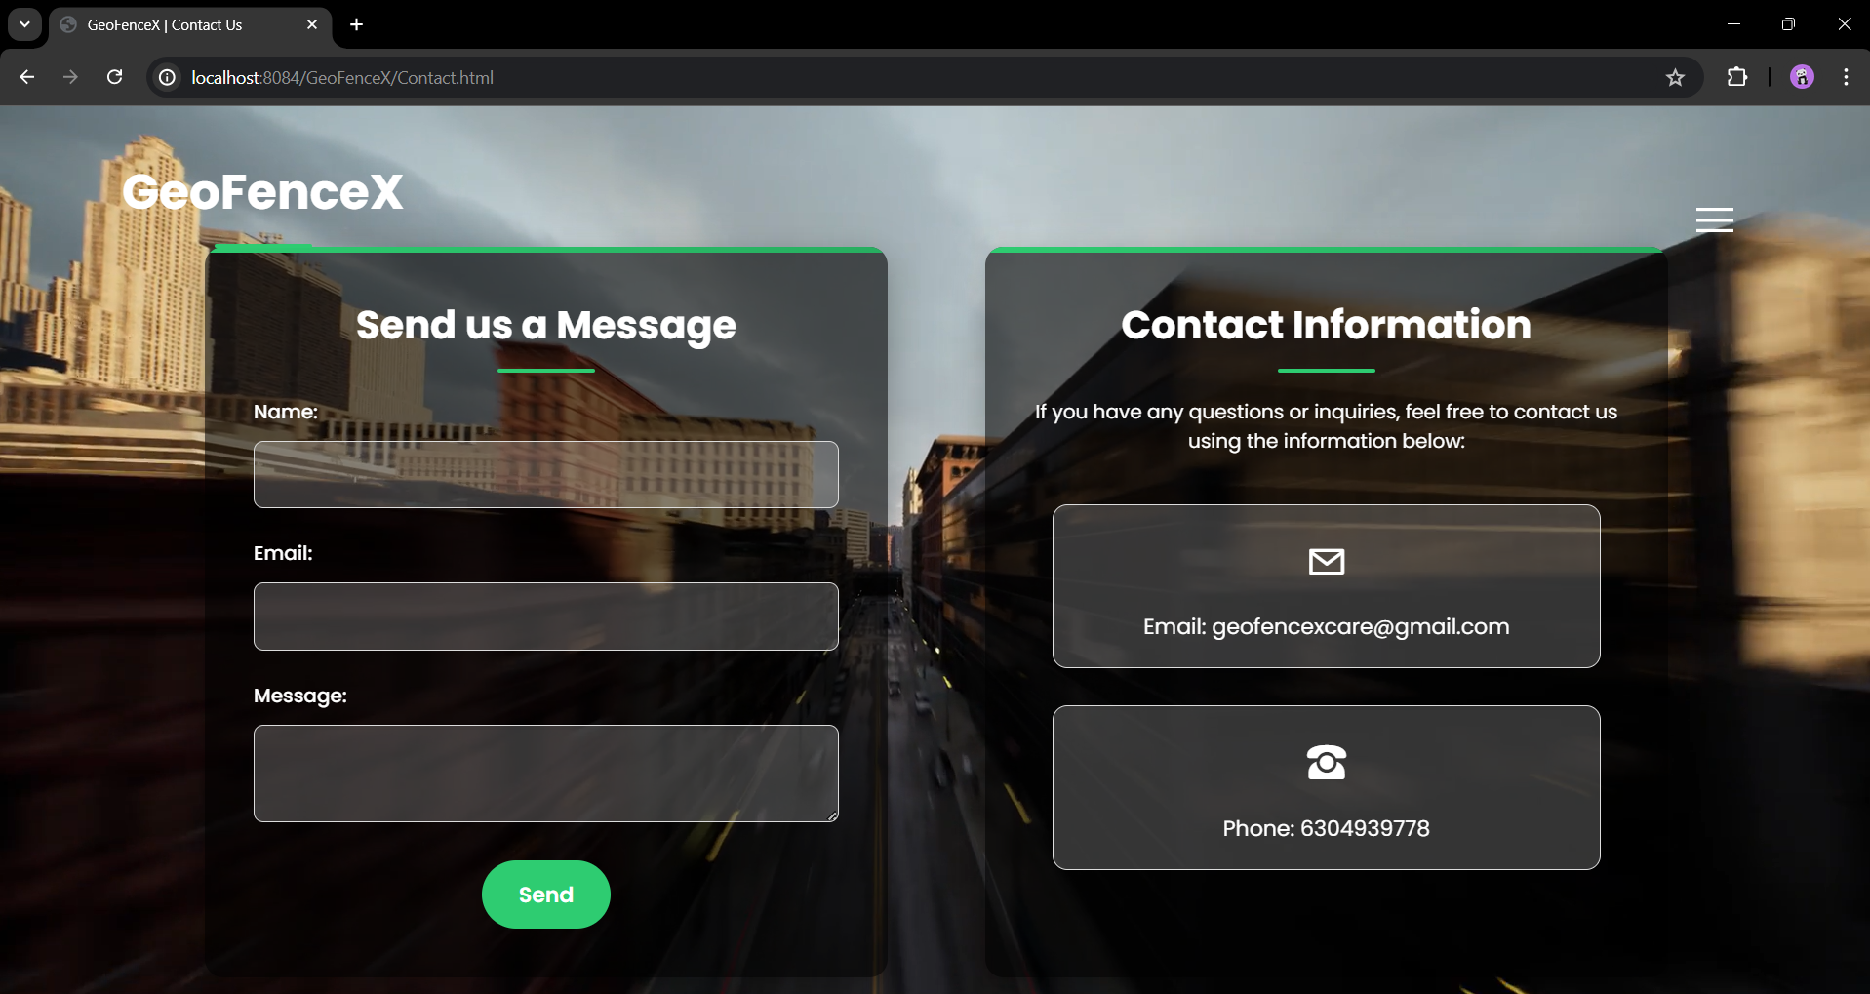
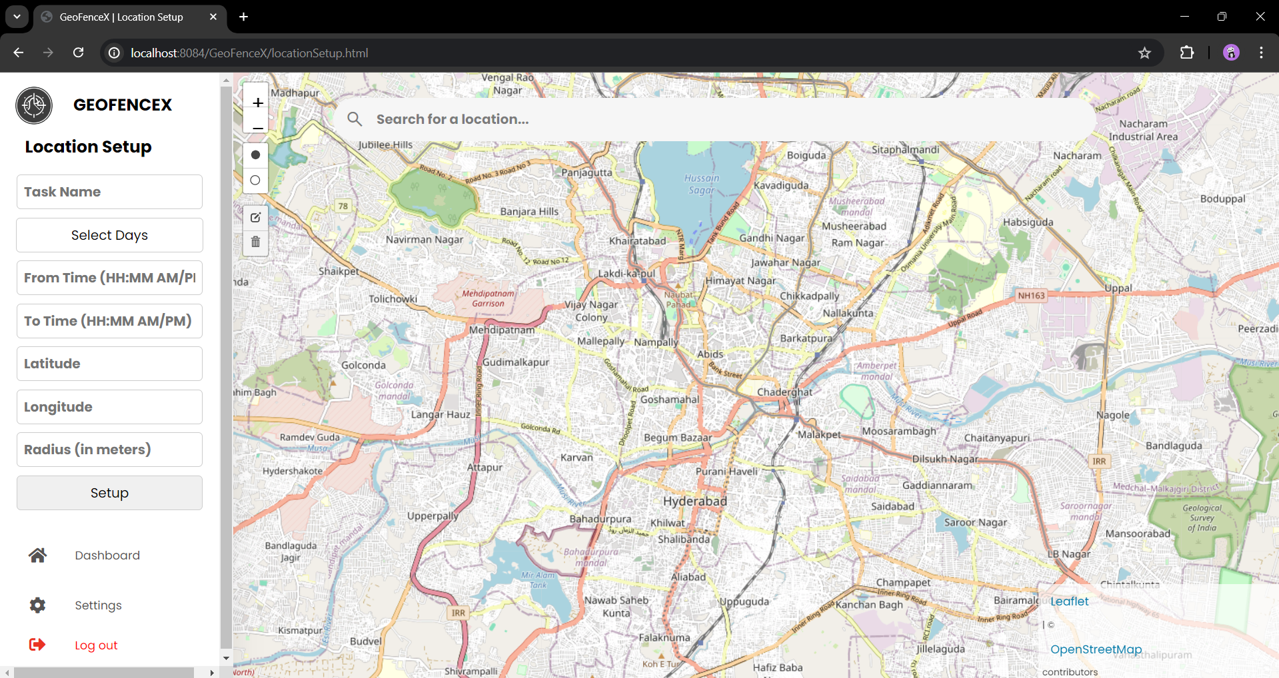
RESULTS
LOCATION SETUP PAGE
CONTACT US PAGE

Slide 20
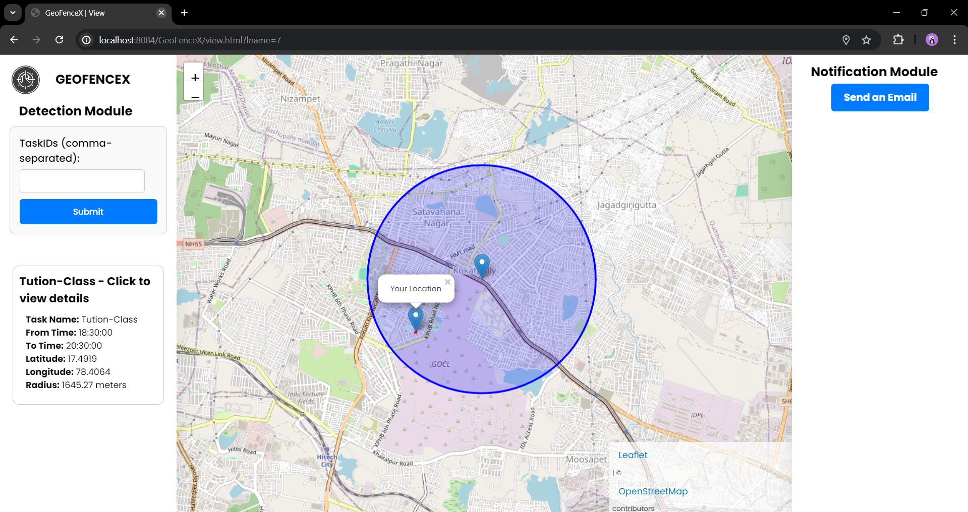
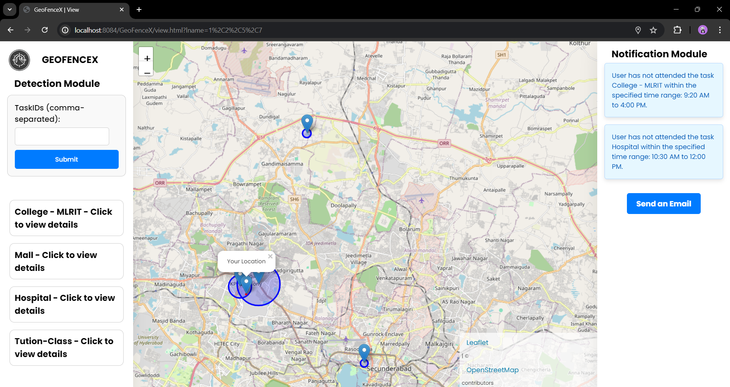
RESULTS
VIEW PAGE WITH SINGLE BOUNDARY
VIEW PAGE WITH MULTIPLE BOUNDARIES

Slide 21
RESULTS
TASK PAGE FOR VIEWING MULTIPLE TASKS
SETTINGS PAGE

Slide 22
CONCLUSIONS
GeoFenceX integrates geofencing with task management, offering reliable solutions for parental supervision and corporate oversight. Utilizing safety and secure data practices, it ensures efficient tracking, management, and alerting based on location data.
This robust platform demonstrates effective use of technology, providing peace of mind for parents and operational efficiency for companies.
With continuous integration of efficient cloud storage and tracking can make it more efficient.

Slide 23
FUTURE ENHANCEMENTS
Predictive Alerts and Behavior Analysis
Implement machine learning for predictive analytics.
Enhanced Security
Introduce multi-factor authentication and encryption.
Advanced Notification Systems
Develop SOS alerts for emergency situations.
IoT and Wearable Integration
Extend functionality with smart devices.
Scalability and UX Improvements
Utilize serverless architecture and enhance user experience.
Safety
Productivity

Slide 24
REFERENCES
R. J. Anto, L. R., H. G., and L. N. S., "Tracking the Covid zones through geo-fencing technique," International Journal of Pervasive Computing and Communications, ahead-of-print, Jul. 2020.
G. Iwasokun, O. Ogunfeitimi, O. Akinyokun, and S. O. Ogunlana, "Geo-Fence Technique for Prevention of Human Kidnapping," International Journal of Smart Security Technologies, Vol. 8, No. 2, pp. 21-41, Jul. 2021.
M. Zurbarán, P. M. Wightman, L. Gonzalez, and M. Labrador, "A Survey on Privacy in Location-Based Services," Ingeniería y Desarrollo, Vol. 32, No. 2, pp. 314-343, August 2014.
A. Babatunde, A. Oke, R. S. Babatunde, and O. Ibitoye, "Mobile Based Student Attendance System Using Geo-Fencing With Timing and Face Recognition,“ Journal of Advances in Mathematical & Computational Sciences, Vol. 10, No. 1, pp. 75-90, Mar. 2022.

Slide 25
THANK YOU
Have Any Queries?

